Slide 1
Cloud Skills Challenge
Azure Fundamentals challenge

Slide 2
Azure Fundamentals Challenge Agenda
1
WHY running a Cloud Skills Challenge in your organization?
2
WHAT to expect for the Cloud Skills Challenge – Azure Fundamentals Challenge?
3
HOW to kick off the Azure Fundamentals Challenge for your collaborators?
Notes:
For ESI customers, the TPM/iTPM must be consulted & provide approval before CSC is implemented. Be sure to always align with TPMs/iTPMs if you are considering running a challenge with ESI customers.
Andrea Waugh Metzger: LOVE Skills Challenge! I had a 60% conversion rate for ACAs last year when I ran challenges

Slide 3
Azure Fundamentals Challenge Why running a Cloud Skills Challenge in your organization?
27% of total roles will be new by 2022 in comparison to 16% in 2018¹
62% of executives believe they need to retrain or replace more than a quarter of their workforce by 2023²
74% of employees ready to completely retrain in order to remain employable in the future³
2018
2022
Skill gaps lead to higher levels of stress, delays in development, deployment of critical projects, and even loss of revenue¹
Invest in upskilling and training your teams with engaging experiences
Reward employees that invest in learning
Prioritize certification in hiring and recruiting
World Economic Forum” The Future of Jobs & Skills 2. McKinsey Survey: Retraining and reskilling workers in the age of automation 3. PwC 2018 Saratoga: Rethinking HR for the future of work
Notes:
For ESI customers, the TPM/iTPM must be consulted & provide approval before CSC is implemented. Be sure to always align with TPMs/iTPMs if you are considering running a challenge with ESI customers.
Andrea Waugh Metzger: LOVE Skills Challenge! I had a 60% conversion rate for ACAs last year when I ran challenges

Slide 4
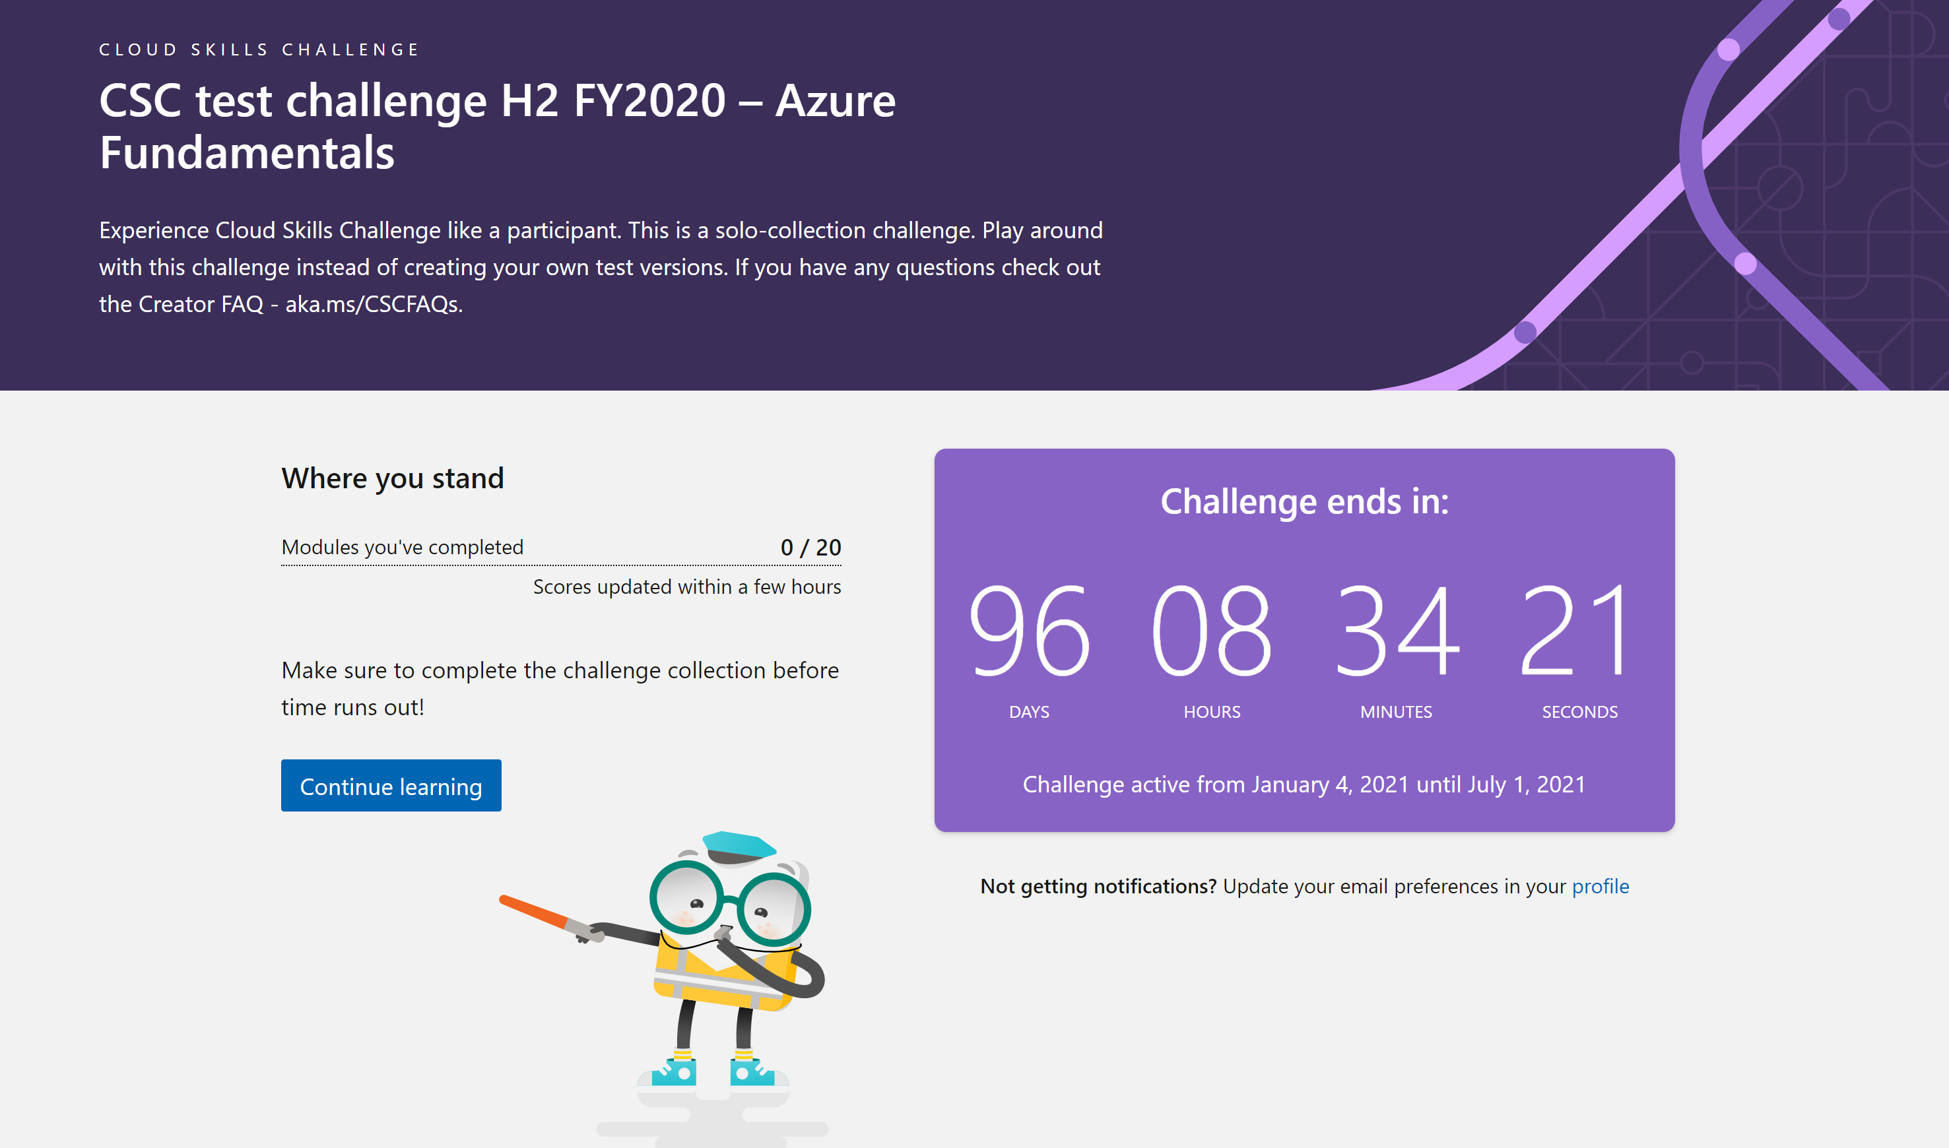
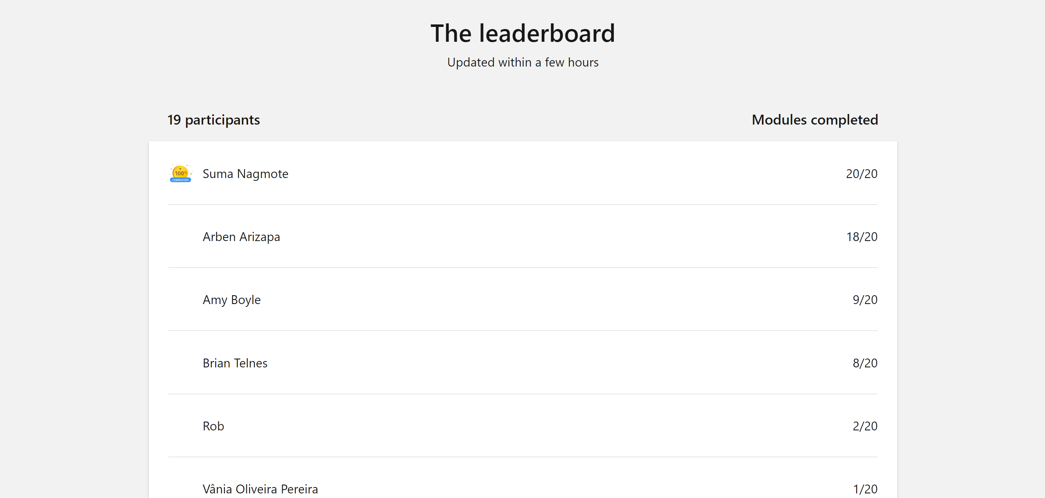
Azure Fundamentals Challenge What to expect for the Cloud Skills Challenge – Kubernetes Bootcamp Edition?
Example
Gamified experience power by Microsoft Learn. The challenge has a timeline and a leaderboard with participants progress, ordered by completed modules.
Notes:
For ESI customers, the TPM/iTPM must be consulted & provide approval before CSC is implemented. Be sure to always align with TPMs/iTPMs if you are considering running a challenge with ESI customers.
Andrea Waugh Metzger: LOVE Skills Challenge! I had a 60% conversion rate for ACAs last year when I ran challenges

Slide 5

Azure Fundamentals Challenge What to expect for the Cloud Skills Challenge – Azure Fundamentals Challenge Edition?
4 weeks self-learning with gamification
Microsoft invites you for the Azure Fundamentals Challenge. In just 4 weeks, you will understand the basics of Azure and get Hands-On experience with its various components and capabilities, including infrastructure, storage, and application services.
Go from zero to hero with Azure to set your company up for future app development success.
Week 1
AZURE FUNDAMENTALS INTRODUCTION
1H30
Week 2
DATABASES, COMPUTE, STORAGE AND NETWORKING BASICS
3H00
Week 3
AZURE SERVICES DEEP-DIVE
2H20
Week 4
SECURITY & GOVERNANCE
4H00
Notes:
For ESI customers, the TPM/iTPM must be consulted & provide approval before CSC is implemented. Be sure to always align with TPMs/iTPMs if you are considering running a challenge with ESI customers.
Andrea Waugh Metzger: LOVE Skills Challenge! I had a 60% conversion rate for ACAs last year when I ran challenges

Slide 6
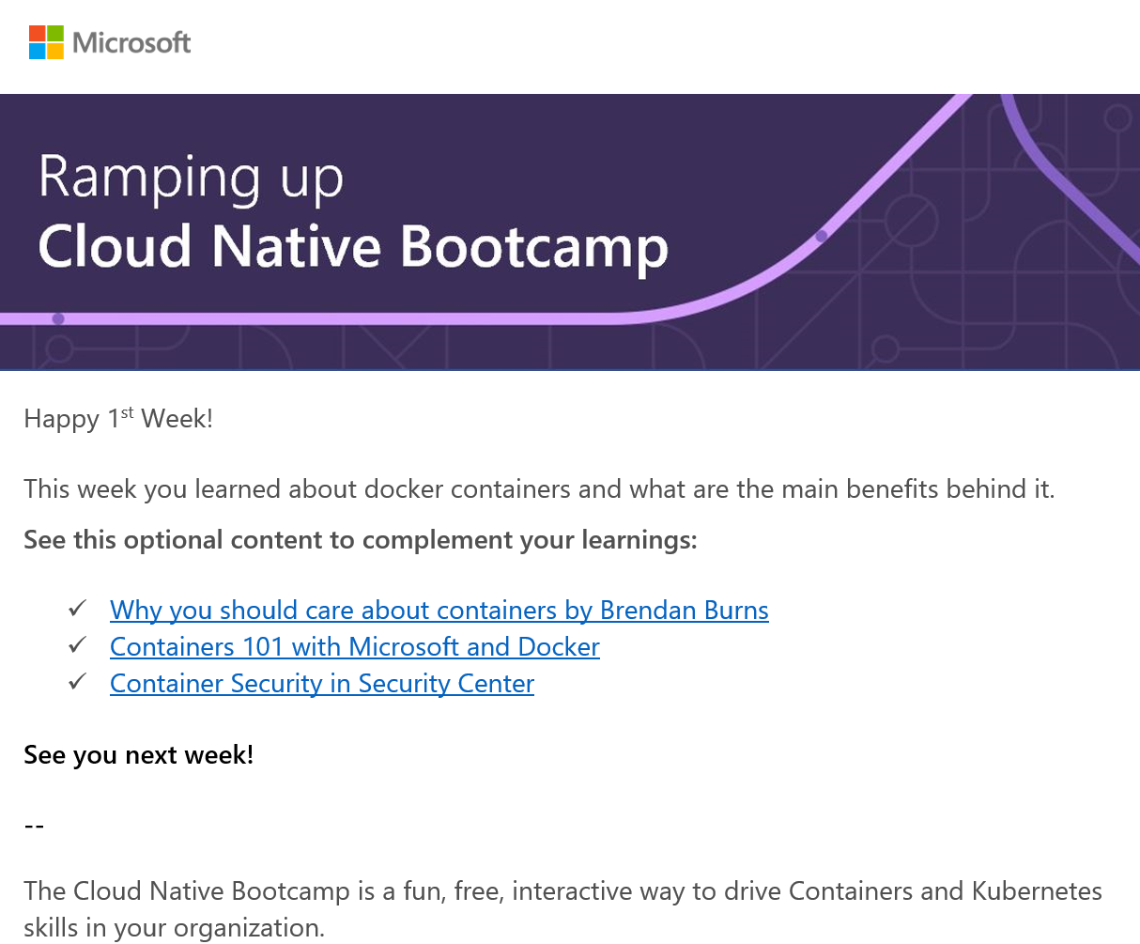
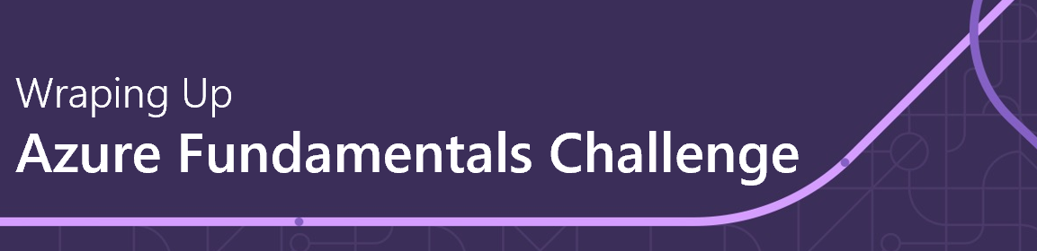
Azure Fundamentals Challenge What to expect for the Cloud Skills Challenge – Azure Fundamentals Challenge?
Kick Off Session | TBD 2021
Weekly Check Up | TBD 2021
Weekly workshop/session to wrap up on the learning and additional content
Happy 1st Week!
This week you learned about the fundamentals of Azure and its main purpose. See this optional content to complement your learnings:
Microsoft Azure Fundamentals | Channel 9 (msdn.com)
What is Azure—Microsoft Cloud Services | Microsoft Azure
Optional Workshops | TBD 2021
Azure Hands-On Workshop
The Azure Fundamentals Challenge is a funny and interactive way of driving techical upskilling in you organization, powered by Microsoft Learn
Notes:
For ESI customers, the TPM/iTPM must be consulted & provide approval before CSC is implemented. Be sure to always align with TPMs/iTPMs if you are considering running a challenge with ESI customers.
Andrea Waugh Metzger: LOVE Skills Challenge! I had a 60% conversion rate for ACAs last year when I ran challenges

Slide 7
Azure Fundamentals Challenge What to expect for the Cloud Skills Challenge – Azure Fundamentals Challenge Edition?
Proposed Calendar
MON | TUE | WED | THU | FRI
 |  |  |  | Wrap Up Session (1h30)
 |  |  |  | Wrap Up Session (1h30)
 |  |  |  | Wrap Up Session (1h30)
 |  |  |  | Wrap Up Session (1h30)
Semana 1
Azure Fundamentals Introduction self-learning gamification, 1h30
Semana 2
Databases, Compute, Storage and Networking Basics self-learning gamification, 3h
Semana 3
Azure Services Deep-Dive self-learning gamification, 2h20
Semana 4
Security & Governance self-learning gamification, 4h
Notes:
For ESI customers, the TPM/iTPM must be consulted & provide approval before CSC is implemented. Be sure to always align with TPMs/iTPMs if you are considering running a challenge with ESI customers.
Andrea Waugh Metzger: LOVE Skills Challenge! I had a 60% conversion rate for ACAs last year when I ran challenges

Slide 8
Azure Fundamentals Challenge How to kick off the Azure Fundamentals Challenge for your collaborators?
1
Choose a sponsor for your organization (IT Director, CIO, CTO)
2
Choose a date to start the Azure Fundamentals Challenge
3
Send the invites and meetings requests provided by Microsoft to potential participants
4
Keep track of the leaderboard and encourage your collaborators together with Microsoft
Notes:
For ESI customers, the TPM/iTPM must be consulted & provide approval before CSC is implemented. Be sure to always align with TPMs/iTPMs if you are considering running a challenge with ESI customers.
Andrea Waugh Metzger: LOVE Skills Challenge! I had a 60% conversion rate for ACAs last year when I ran challenges

